Slide 1
Data Science
Machine Learning
Today's Topic – Ensemble Models
Classifiers
Random Forest and Boosting
In this file:
Bagging (averaging, voting) vs Boosting (incremental correction)
Ensemble Learning, Trees, Random Forest vs Boosing
Binary Classification - Islands - when linear separation doesn't work
Decision Tree - and how to build it
Building Tree - Gini Impurity
Building Tree - Smallest Entropy
Building Tree – CHAID
Random Forest – authors
Bagging – Boosting – Stacking
Random Forest diagram
Bootstrap Sampling
Boosting Authors
Gradient Descent, Gradient Boosting, Validation
Ada Boost diagram
Misc. links

Slide 2
Idea:
make a reliable system from unreliable blocks using single-shot democratic voting
Idea:
get to correct answer by making multiple corrective steps
Power of the majority
committee, senate, congress, council, board of directors, ...
1st approximation
Power of validation
science, open source community, ...
Computer 1
correction
Data
Computer 2
Majority voting
system
Weighted
voting
system
correction
Computer 3
...
correction
Bagging
Wrong bias is not removed,
it is simply averaged
Wrong bias is removed
using correction and validation
Boosting

Slide 3

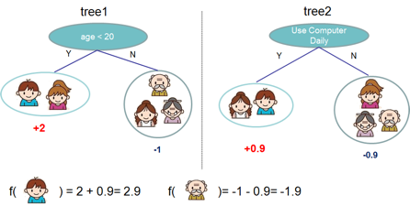
Ensemble Learning
Idea - train several models to do predictions.
Then combine predictions of these models to get a better predictor.
It is possible to combine any types of models into one predictor.
But commonly people combine variations of similar models, like decision trees models.
Two most famous approaches are:
- "Random Forest"
- "Gradient Boosted Trees"
Under the hood these models combine 100 ... 200+ similar trees.
The differences between algorithms:
how you select the data to train those trees
how you combine the predictions of these trees

Slide 4
Binary Classification Problem
Example – two classes: red and grey.
Ensemble Tree Classifiers succeed
where Linear Classifiers fail
Ensemble tree classifiers
( Random Forest , XGBoost )
can solve complicated problems

Slide 5
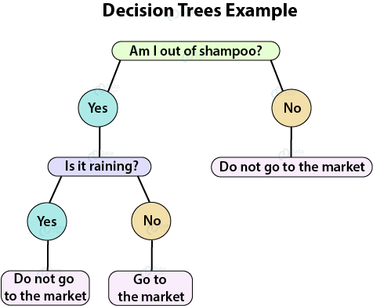
Decision Tree (DT)
DT goes from observations about an item (represented in the branches) to conclusions about the item's target value (represented in the leaves).
DT can do classification or regression.
DTs are intuitive and easily interpretable.
Algorithms for constructing DTs usually work top-down, by choosing and splitting on a variable at each step that most informative for the target label (produces the purest daughter nodes).
Splits can result in more than two branches.
Decision Tree Building Algorithms
ID3 (Iterative Dichotomiser 3) – uses smallest Entropy metrics
C4.5 – successor of ID3 (since 1993), uses Entropy metrics
CART (Classification And Regression Tree) – (since 1984), uses Gini metrics
CHAID (CHi-squared Automatic Interaction Detector). Performs multi-level splits when computing classification trees.
MARS: extends decision trees to handle numerical data better.
Conditional Inference Trees. Statistics-based approach that uses non-parametric tests as splitting criteria, corrected for multiple testing to avoid overfitting. This approach results in unbiased predictor selection and does not require pruning.
Trees:
Greedy splitting (top->down)
Greedy pruning (to prevent over-fitting)
Fast and easy to build
Surprisingly good
Explainable

Slide 6
Splitting Criteria for Decision Trees: Information Gain
We want splits which are very un-even.
Information Gain(S,A) = expected reduction in entropy due to branching on feature "A" = original entropy – entropy after branching.
Perfect Information gain is splitting into many individual events. We don't want that.
So we use Information Gain Ratio (Quinlan, 1986)
From: Cynthia Rudin - https://users.cs.duke.edu/~cynthia/CourseNotes/DecisionTreeSlides.pdf

Slide 7
Trivial Tree Example
showing how Gini Impurity or Entropy decrease as we go deeper
[0,1]
Gini = 1-sum(p²) = 1-(0.25+0.25) = 0.5
Entropy = -(0.5lg₂(0.5)+0.5lg₂(0.5))
= 2*(0.5+0.5) = 1
Big Impurity
[0]
Gini = 1-sum(p²) = 1-1 = 0
Entropy = - 1*lg₂1 = 0
[1]
Gini = 1-sum(p²) = 1-1 = 0
Entropy = - 1*lg₂1 = 0
Pure

Slide 8
Common splitting criteria:
Entropy = H([p,1-p])
Gini Index = 2p(1-p) = variance of Bernoulli
Misclassification Error = 1-max(p,1-p) = majority vote

Slide 9
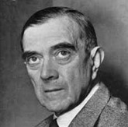
Gini Impurity
If you look at the documentation for the DecisionTreeClassifier class in scikit-learn, you’ll see something like this for the criterion parameter:
Gini Impurity (I_{G}) - metrics used by CART method for making splitting decisions on categorical features.
Gini impurity is a measure of how often a randomly chosen element from the set would be incorrectly labeled if it was randomly labeled according to the distribution of labels in the subset.
Gini max value is 0.5, and min value is 0 (when all cases in the node fall into a single target category).
If we have a set of items with J classes {1,2,..,J},
and p_{i} is the fraction of items of i-th class, then it can be shown that :
I_{G} = 1 – sum(p_{i}²)
When training a decision tree, the best split is chosen by maximizing the Gini Gain, which is calculated by subtracting the weighted impurities of the branches from the original impurity - https://victorzhou.com/blog/gini-impurity/
Name "Gini" comes from economics.
Corrado Gini - Italian statistician and sociologist.
He has published his paper Variability and Mutability in 1912.
He has introduced a Gini coefficient, sometimes called the Gini index or Gini ratio.
It is a measure of statistical dispersion intended to represent the income inequality or wealth inequality within a nation or any other group of people.
Gini coefficient ranges from 0 (or 0%) to 1 (or 100%), with
0 representing perfect equality
1 representing perfect inequality.
Corrado Gini
1884-1965
fraction of incorrectly labeled
Note:
Gini Impurity – for categorical variables (0 ... 0.5)
Gini Coefficient – for numeric variables (income) (0 ... 1)
They are two different (but similar) metrics.
But both measure "variation".
Both can be named "Gini Index"

Slide 10
CART – Tree Building Algorithm
CART = Classification and Regression Trees
(Breiman, Friedman, Olshen, Stone, 1984)
Leo Breiman
UC Berkeley
Statistics
1928-2005
• Does only binary splits, not multiway splits.
• Uses the Gini index for splitting.
• Uses Minimum Cost Complexity for pruning

Slide 11


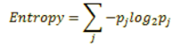
Smallest Entropy (Largest Information Gain)
ID3 (ID.3 = Iterative Dichotomiser 3)
an algorithm invented by Ross Quinlan (1986)
used to generate a decision tree from a dataset
splits data by an attribute that has smallest average entropy of the split (or largest information gain)
C4.5 is an extension of ID3, used for classification, has following advantages:
handles both continuous and discrete attributes (creates a threshold and then splits the list)
handles missing attributes data (simply not using them in entropy calculations).
handles attributes with differing costs
pruning trees after creation (attempts to remove inefective branches or replace them with leaf nodes).
C5.0 algorithm - improved C4.5:
- https://www.rulequest.com/see5-info.html - https://www.rulequest.com/download.html
much-much faster
less memory usage
builds smaller decision trees
support for boosting
support for weighting
automating winnowing (removing not effective attributes)
John Ross Quinlan
Inventor of canonical C4.5 and ID3 algorithms. Currently running his company RuleQuest Research.
- https://www.rulequest.com/Personal/
- https://www.rulequest.com/
Pure node : entropy = 0
Information Gain = 1 - Entropy

Slide 12
Splitting using Gini or Entropy
From these excellent short videos by Bhavesh Bhatt:
Gini: https://www.youtube.com/watch?v=2lEcfRuHFV4
Entropy : https://www.youtube.com/watch?v=mQaAPoRGOcs
Given the data on the right, train model to predict the "PlayTennis" value.
Yes = P = Play, No = N = Not play
There are 14 rows: 5 N-s and 9 P-s in target column.
Making a Split (into 2 or more branches)
Gini Impurity
Entropy
Entropy S = -p₊log₂p₊ -p₋log₂p₋
where p₊ - proportion of positive examples
p₋ - proportion of negative examples
Information Gain:
Gain(S,A) = S – sum(entropies of pieces after split)
Original Entropy S = (-0.36)log2(0.36) – (0.64)log2(0.64) = 0.94
After splitting by Wind:
Gain(S,Wind) = 0.94 – 1.0*(6/14) + 0.811*(8/14) = 0.048
Do similar calculations for other columns:
Outlook : 0.247 ← split on this (maximum)
Temperature : 0.029
Humidity : 0.151
Windy : 0.048
Gini (PlayTennis | Wind=Strong) = 1 – (3/6)² – (3/6)² = 0.5
Gini (PlayTennis | Wind=Weak ) = 1 – (3/8)² – (2/8)² = 0.375
After splitting by Wind, total Gini = 0.5 * (6/14) + 0.375 * (8/14) = 0.4286
Do similar calculations for other columns:
Outlook : 0.3429
Temperature : 0.4405 ← split on this (maximum)
Humidity : 0.3674
Windy : 0.4286

Slide 13
CHAID – Chi-Squared Automatic Interaction Detection
Decision Tree
Building Algorithm
CHAID - Chi-Squared Automatic Interaction Detection.
It was originally proposed by Gordon V. Kass in 1980
- https://en.wikipedia.org/wiki/Chi-square_automatic_interaction_detection
This algorithm used only for categorical variables.
In practice, CHAID is often used in the context of direct marketing to select groups of consumers and predict how their responses to some variables affect other variables.
Good explanation of CHAID vs CART:
https://towardsdatascience.com/clearly-explained-top-2-types-of-decision-trees-chaid-cart-8695e441e73e

Slide 14
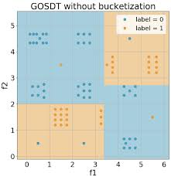
Modern Decision Tree Methods
Most recent method is called GOSDT – Generalized and Scalable Optimal Sparse Decision Trees (Lin et al, ICML 2020)
- https://arxiv.org/pdf/2006.08690.pdf
Aim for full minimization of the Cost Complexity objective
Sparsity
Can prove optimality or nearness to optimality for not-huge datasets
Not greedy splitting and pruning
Sophisticated pairing of theoretical bounds for reducing the search space with techniques for careful storage+lookup of previously-solved subproblems. (Dynamic programming + analytical bounds)
Advantages of GOSDT
Interpretable, simple models that generalize well
Handles nonlinearities
Handles wide variety of objectives, even custom objectives
Handles imbalanced data
Proof of optimality, or closeness to optimality
No splitting and pruning heuristics
Disadvantages of GOSDT
Can’t prove optimality for big datasets… yet

Slide 15
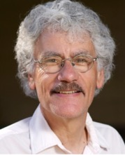


FORTRAN
Random Forest
2002-2003
Richard A. Olshen
Biostatistics
UC Berkeley,
Stanford
1942-
Charles J. Stone
Math, Probability
UCLA,
UC Berkeley
1936-2019
Leo Breiman
UC Berkeley
Statistics
1928-2005
Jerome H. Friedman
Statistics
UC Berkeley,
Stanford
1939-
Classification and
Regression Trees
(1984) by BFOS (BFOS = Breiman, Friedman, Olshen, Stone)
Random Decision Forests
(1995) by Tin Kam Ho
Adele Cutler
UC Berkeley, then Utah State University.
Wrote original Random Forest in Fortran with Leo Breiman in 2002-2003
https://www.stat.berkeley.edu/~breiman/RandomForests/cc_software.htm
Tin Kam Ho
at Bell Labs in NJ.
then AI at IBM (since 2014)

Slide 16
Ensemble Learning Methods with Decision Trees
A group of “weak learners” come together to form a “strong learner”
Bagging
reduces variance (averages)
does NOT reduce bias error
Boosting
reduces bias error
by sequential corrective learning
Stacking
improves predictive force (combines "skills" of different models)
Random Forest – parallel independent learners, democratic equal-weight voting.
Note - Random Forest is a specific case of Bagging = Bootstrap Aggregating
Bootstrap = data sampling with replacement
Aggregating = voting
Each learner gets a random subset of data (rows) and a random subset of features (columns).
Each tree is trained independently.
Each tree then can make its prediction.
Then overall decision is made by averaging decisions of individual trees.
Boosted Trees – trees trained sequentially.
Train 1st tree
Train 2nd tree concentrating on fixing errors left after 1st tree, combine trees (weighted voting)
Train 3rd tree concentrating on fixing errors left after 1st and 2nd trees, etc.
Continue boosting accuracy by adding trees.
Stacking (Meta-learner) - train several different models, and then train model on top of their outputs
- https://www.kdnuggets.com/2017/02/stacking-models-imropved-predictions.html

Slide 17
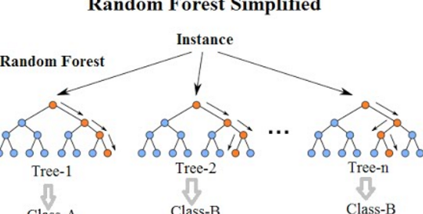

Slide 18
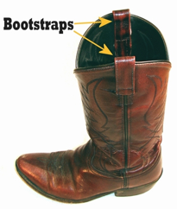
Bootstrap Sampling
method of preparing a set of data samples
by sampling them (with replacement) from original data set
Another meaning of the word bootstrap:
"pull oneself over a fence by one's bootstraps"

Slide 19



Boosting Algorithms
Strength of Weak Learners
AdaBoost (1995) Yoav Freund & Robert Schapire
(2003 Gödel Prize).
Leo Breiman
UC Berkeley
Jerome H. Friedman
UC Berkeley,
Stanford
From Wikipedia, etc:
The idea of gradient boosting originated in the observation by Leo Breiman that boosting can be interpreted as an optimization algorithm on a suitable cost function (1997, Berkeley).
Explicit regression gradient boosting algorithms were subsequently developed by Jerome H. Friedman (1999, Berkeley).
... simultaneously with the more general functional gradient boosting perspective of Llew Mason, Jonathan Baxter, Peter Bartlett and Marcus Frean (1999).
Stochastic gradient boosting - by Jerome H.Friedman, 2002 – adding random sampling to gradient boosting algorithm improves speed and accuracy.
XGBoost (2014)
more flexible and optimized
Tianqi Chen (was a Ph.D. student)
Light GBM (2016, Microsoft) fast-performing, distributed
(GBM = Gradient Boosting Machine)
CatBoost (2017, Yandex)
big data, categorical data, multiple GPUs.

Slide 20
Comparing Regressors
# from sklearn.ensemble:
GradientBoostingRegressor
HistGradientBoostingRegressor # (best, inspired by LightGBM)
RandomForestRegressor
ExtraTreesRegressor
# from xgboost !pip install xgboost
XGBRegressor
XGBRFRegressor
All regressors have similar speed and accuracy.
But the best is HistGradientBoostingRegressor - histogram-based gradient boosting.
https://scikit-learn.org/stable/modules/generated/sklearn.ensemble.HistGradientBoostingRegressor.html
https://machinelearningmastery.com/histogram-based-gradient-boosting-ensembles/
https://inria.github.io/scikit-learn-mooc/python_scripts/ensemble_hist_gradient_boosting.html
Why the "histogram-based" approach is faster and better?
The bottleneck in training any boosted trees algorithm is the time
needed for finding the best split between values when building the trees.
This time can be significantly reduced if we pre-process the data for a given tree – aggregate them into "bins".
We convert the continuous float numbers into limited number of discrete integer values.
This "histogram binning" reduces the number of splits we need to try to find the best split.
This makes finding the split much faster, but reduces the accuracy.
To increase the accuracy we can simply increase the number of trees.

Slide 21
Missing Values
When we do predictions, we often have most recent data which may have nulls.
RandomForest doesn't support missing values.
But XGBoost and HistGradientBoosting can deal with missing values!
https://www.youtube.com/watch?v=jbc6BPQEM3o
https://scikit-learn.org/stable/modules/generated/sklearn.ensemble.HistGradientBoostingClassifier.html
https://scikit-learn.org/stable/modules/generated/sklearn.ensemble.HistGradientBoostingRegressor.html
RandomForest trains faster and shows feature inportance. So it is good during model development (feature engineering).
Boosting trees train slower, but they usually provide better accuracy and can handle missing values. So they are good in production.
Note: For feature importance analysis with Boosting we can use SHAP (SHapley)
https://christophm.github.io/interpretable-ml-book/shap.html
https://github.com/slundberg/shap
It is possible to use XGBoost to automatically predict and fill-in all missing values: There is even a special module for that: pip install verstack https://medium.com/swlh/impute-missing-values-the-right-way-c63735fccccd Read this excellent discussion comparing handling nulls by RandomForest and Boosting algorithms:
https://stats.stackexchange.com/questions/98953/why-doesnt-random-forest-handle-missing-values-in-predictors
import xgboost, shap
X, y = shap.datasets.boston()
model = xgboost.XGBRegressor().fit(X, y)
explainer = shap.Explainer(model)
shap_values = explainer(X)
shap.plots.waterfall(shap_values[0])

Slide 22
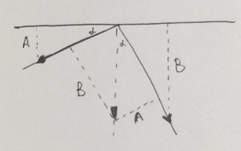
"validation data set" – used in boosting to figure out when to stop iterations to avoid overfitting
Gradient Boosting
is named so because on each steep
it is improving (boosting) the decision
by decreasing the error (Gradient Descent)
Gradient Descent
Gradient vector is perpendicular to level curves
Understand gradient vector

Slide 23
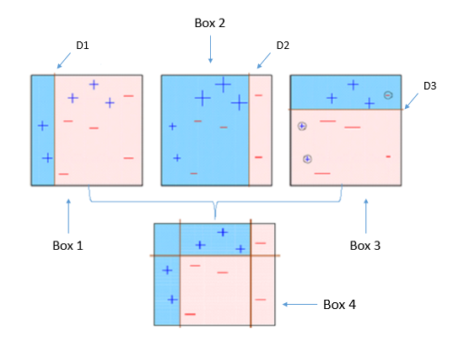
AdaBoost
First Boosting Algorithm
(1995) by Freund and Schapire

Slide 24
Gradient Boosting – links:
- https://en.wikipedia.org/wiki/Gradient_boosting
- https://en.wikipedia.org/wiki/Xgboost
Gradient boosting trees model is originally proposed by Friedman et al.
He has coined the term GBM = Gradient Boosting Machine
“Gradient Boosting” - Greedy Function Approximation: A Gradient Boosting Machine, by Friedman (1999)
- https://statweb.stanford.edu/~jhf/ftp/trebst.pdf
XGBoost was created by Tianqi Chen. It is a library implementing GBM – and optimized for trees.
"XG" in XGBoost = “Extreme Gradient Boosting”.
Tianqi Chen - Introduction to Boosted Trees (2016)
- http://homes.cs.washington.edu/~tqchen/pdf/BoostedTree.pdf
- https://xgboost.readthedocs.io/en/latest/model.html
XGBoost
- uses "Regularized Gradient Boosting" model which prevents overfitting and gives better performance
- uses sparse matrices with sparsity aware algorithms to reduce memory and increase performance
- better support for multicore parallel processing - reduces training time
XGBoost + GPU:
- https://developer.nvidia.com/blog/scikit-learn-tutorial-beginners-guide-to-gpu-accelerating-ml-pipelines/
- https://developer.nvidia.com/blog/accelerating-random-forests-up-to-45x-using-cuml/
XGBoost with GPU on Windows
- https://towardsdatascience.com/xgboost-with-gpu-on-windows-759ee8180214
XGBoost GPU Support
- https://xgboost.readthedocs.io/en/release_0.81/gpu/index.html
Accelerating XGboost with GPU (2019)
- https://www.kaggle.com/vinhnguyen/accelerating-xgboost-with-gpu
Gradient Boosting, Decision Trees and XGBoost with CUDA (2017, Nvidia)
- https://developer.nvidia.com/blog/gradient-boosting-decision-trees-xgboost-cuda/

Slide 25
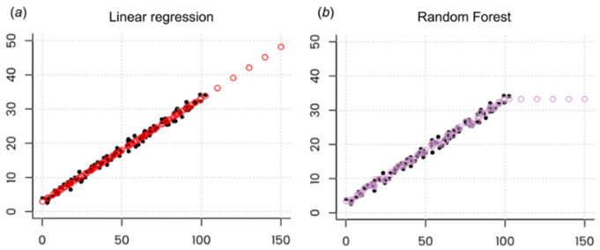
RandomForestRegressor can not extrapolate
For time series forecasting you can use 3-step approach: remove trend (usually linear, quadratic, or exponential), then use the regressor, then add the trend back.
You can also use SVM regression, Linear Regression, Deep Learning (RNN), combining predictors using stacking, etc.
You can also use can use modified versions of random forest, for example Regression Enhanced Random Forest (RERF, 2017): https://arxiv.org/pdf/1904.10416.pdf
RF does interpolation for values inside the range of values.
But it can not go outside.
- https://neptune.ai/blog/random-forest-regression-when-does-it-fail-and-why
RandomForest Regressor works by finding closest matches in given range.
We take random subset of data (columns, rows), and build a tree splitting by "x".
Each leave has "x" and "y".
We build hundred trees like this.
For inference, given value "x" we traverse all 100 trees (by "x") and find 100 values of "y".
Then we average them to get the desired prediction.
The result is always within the range of "y" values. It can not extrapolate.
If you look at predicted values, they will look like this:
Note: Boosting algorithms with default RMSE loss function can have 1-2 % of predictions going outside of the range. For example, we were getting negative duration (in days) although the training data has contained only positive number of days. We solved this problem by switching loss function to "count poison".
The GradientBoostingRegressor (assuming a squared error loss function) successively fits regression trees to the residuals of the previous stage. Now if the tree in stage "i" predicts a value larger than the target variable for a particular training example, the residual of stage "i" for that example is going to be negative, and so the regression tree at stage "i+1" will face negative target values (which are the residuals from stage "i"). The boosting algorithm adds up all these trees to make the final prediction – thus you may end up with some negative values (especially when you increase number of trees and use some categorical features)
https://datascience.stackexchange.com/questions/565/why-does-gradient-boosting-regression-predict-negative-values-when-there-are-no

Slide 26
Why does XGBoost regression predict completely unseen values
https://github.com/dmlc/xgboost/issues/1581
https://datascience.stackexchange.com/questions/77234/can-boosted-trees-predict-below-the-minimum-value-of-the-training-label/77272
from sklearn.datasets import make_classification
from sklearn.ensemble import GradientBoostingRegressor, HistGradientBoostingRegressor
from xgboost.sklearn import XGBRegressor
# 100 rows, 20 features, y-values are only 0 or 1
X, y = make_classification(random_state=42)
# -----------------------------------------------------
print("GradientBoostingRegressor")
for max_depth in [1,2,5,10,20,50]:
model = GradientBoostingRegressor(max_depth=max_depth,
n_estimators=10,
learning_rate=1,
random_state=42)
model.fit(X,y)
preds = model.predict(X)
print(f"{max_depth:3d}: {preds.min():.5f}, {preds.max():.5f}")
# -----------------------------------------------------
# Output
1: -0.01042, 1.13457
2: -0.00050, 1.00104
5: 0.00000, 1.00000
10: 0.00000, 1.00000
20: 0.00000, 1.00000
50: 0.00000, 1.00000
# -----------------------------------------------------
# Try the same with other models – they behave differently
# (do not converge to 0 or 1):
# model = HistGradientBoostingRegressor(max_depth=max_depth)
# model = XGBRegressor(max_depth=max_depth)
# model = XGBRegressor(max_depth=max_depth, objective='count:poisson')

Slide 27
More links
"DART: Dropouts meet Multiple Additive Regression Trees" (2015)
by K. V. Rashmi, Ran Gilad-Bachrach
- https://arxiv.org/abs/1505.01866
Also:
- http://zhanpengfang.github.io/418home.html
- https://www.analyticsvidhya.com/blog/2016/03/complete-guide-parameter-tuning-xgboost-with-codes-python/
- https://www.quora.com/What-is-the-difference-between-the-R-gbm-gradient-boosting-machine-and-xgboost-extreme-gradient-boosting
Videos of Leo Breiman, Jerome Friedman, CART, BFOS:
- https://www.youtube.com/watch?v=t8ooi_tJHSE – 2 min, Working with Leo Breiman on Random Forests, Adele Cutler
- https://www.youtube.com/watch?v=JIXeMj1zwVU – 5min, CART
- https://www.youtube.com/watch?v=-Ju0Czc9GmA – 4min, The Birth of BFOS: Breiman, Freidman, Olshen and Stone
- https://www.youtube.com/watch?v=XaeQo1KSmjA – 4min, CART and Cross-Validation, Data Mining
- https://www.youtube.com/watch?v=8hupHmBVvb0 – 4min, Jerome Friedman, Data Mining Software Founding Father
CART = Classification and Regression Trees
BFOS = Breiman, Friedman, Olshen, Stone

Slide 28
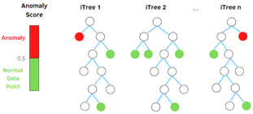
Anomaly Detection: Isolation Forest (IF) & RRCF
(RRCF = AWS Robust Random Cut Forest)
https://en.wikipedia.org/wiki/Isolation_forest -
https://stackoverflow.com/questions/63115867/isolation-forest-vs-robust-random-cut-forest-in-outlier-detection – Isolation Forest:
https://cs.nju.edu.cn/zhouzh/zhouzh.files/publication/icdm08b.pdf – paper
https://towardsdatascience.com/outlier-detection-with-isolation-forest-3d190448d45e – tutorial RCF:
http://proceedings.mlr.press/v48/guha16.pdf – paper
https://freecontent.manning.com/the-randomcutforest-algorithm/ - tutorial
Both algorithms are ensemble methods based on decision trees.
Both aim to isolate every single point.
Ouliers tend to require less steps to get isolated.
Isolation Forest (IF) is open source (sklearn), whereas AWS RRCF is closed source (although look at https://github.com/kLabUM/rrcf )
RRCF can work on streams (in streaming analytics service Kinesis Data Analytics) – it has partial_fit() method.
RRCF is more scalable, can be parallelized between multiple machines. It also supports Pipe mode (streaming data via unix pipes) which makes it able to learn on much bigger data than what fits on disk
RRCF performs better in high-dimensional space because it gives more weight to dimension with higher variance (according to SageMaker doc), while Isolation Forest samples at random
Anomaly score is calculated differently. IF's score is based on distance from the root node. RRCF is based on how much a new point changes the tree structure (i.e., shift in the tree size by including the new point). This makes RRCF less sensitive to the sample size

